Slide 1


Plug Load Signature Study for Home Energy Management
Kelvin Liang, Young Min Kim,
Johnny Nguyen
Advisor: Prof. G.P. Li, Dr. Arthur Zhang

Slide 2
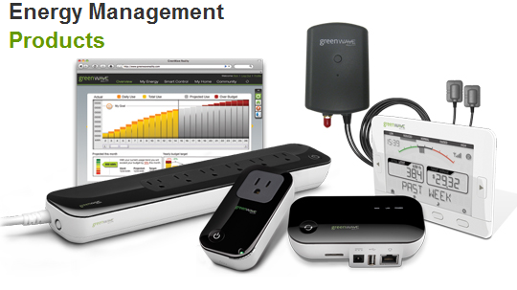
What is an EMS?
Central hub for monitoring plug load devices used in the house.
Monitoring
Power Consumption
Cost
User behavior
Opportunities for energy management
Two way communication

Slide 3
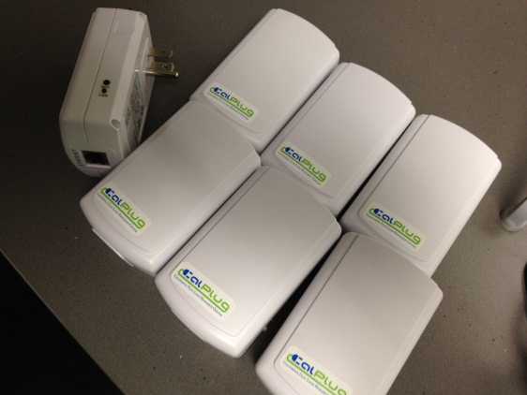
Smarter Technology
Current systems
Module for each plug load device
100% User Interaction
Load Signature allows for:
Automatic Identification
Using existing infrastructure (electrical panel, switch boxes, outlets)

Slide 4

Load Signatures
Current Waveform
Active & Reactive Power
Harmonics
Operating Behaviors

Slide 5
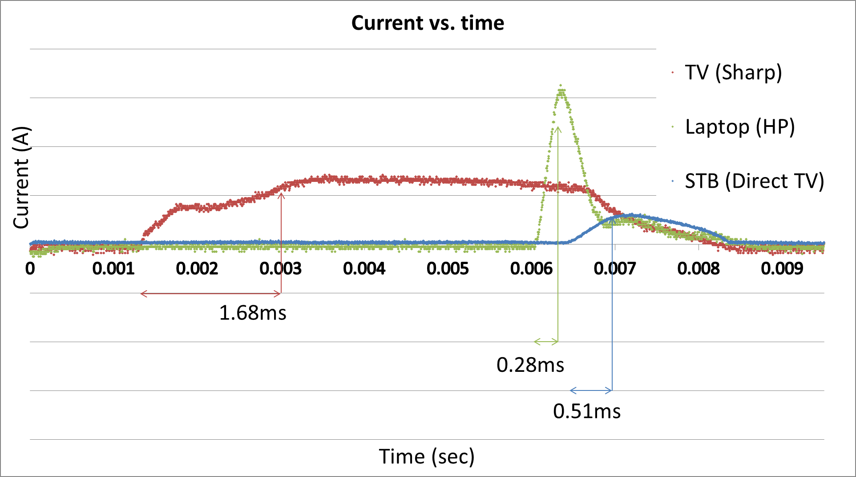
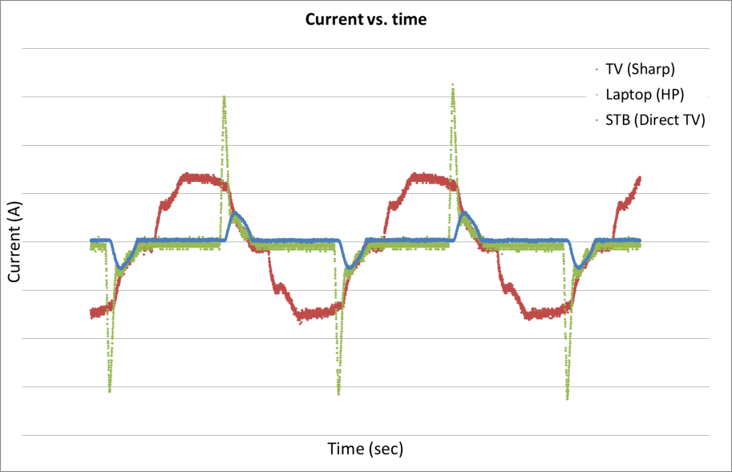
Current Waveform
Signature I: Current Rise-Up Time

Slide 6
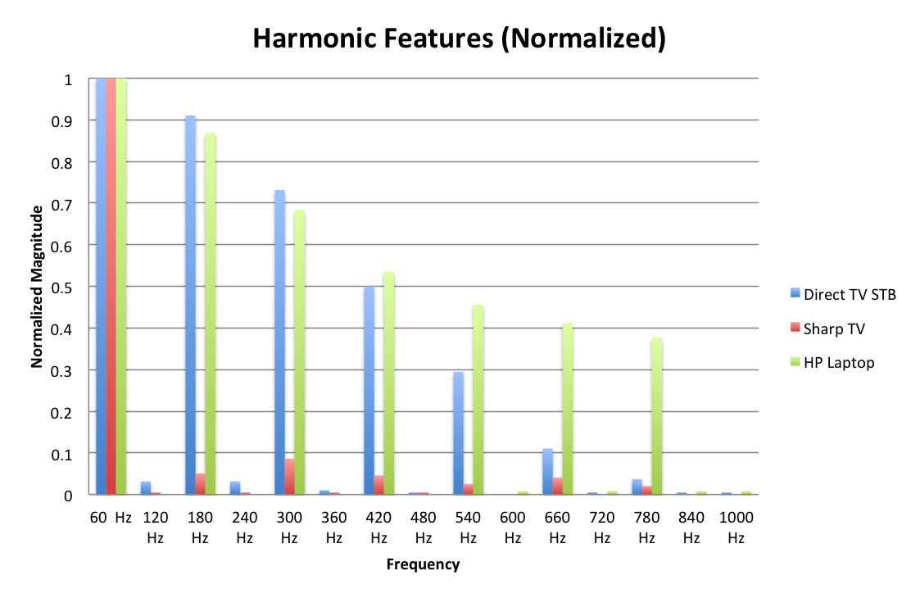
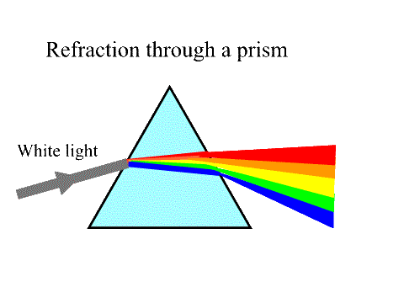
Signature II: Harmonics
Prism Analogy

Slide 7
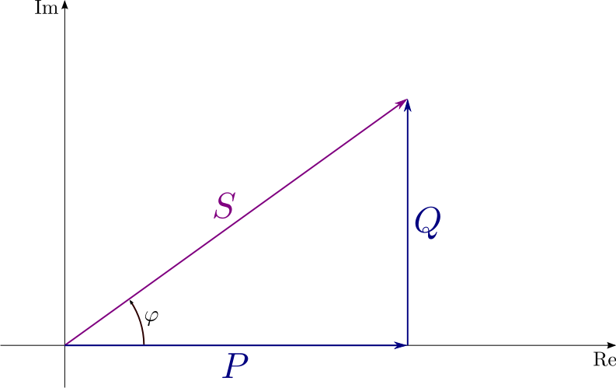
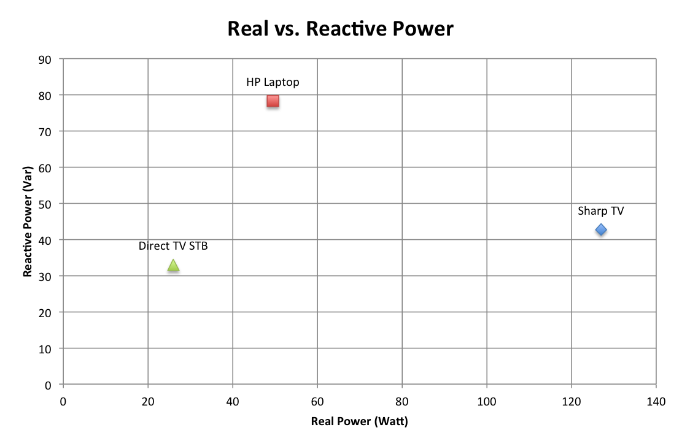
Signature III: Active & Reactive Power
Real power (P)
Reactive power (Q)
Complex power (S)
Phase of Current (φ)

Slide 8
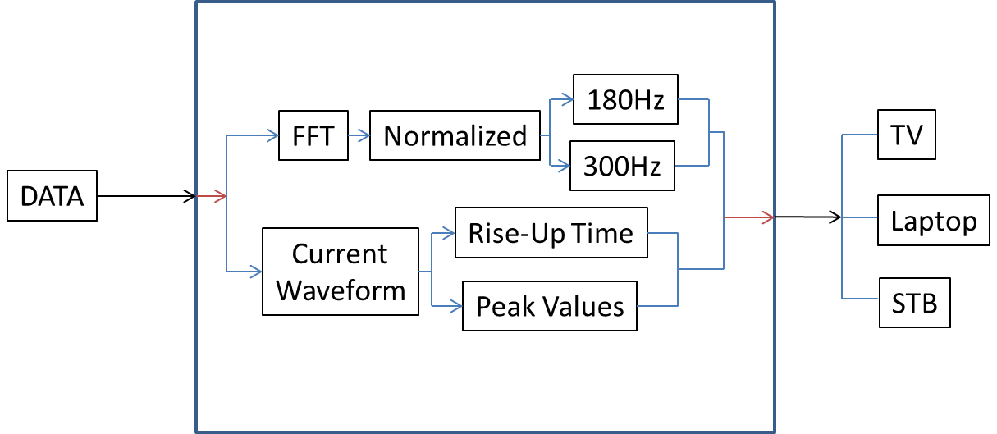
Current Algorithm Design
?

Slide 9
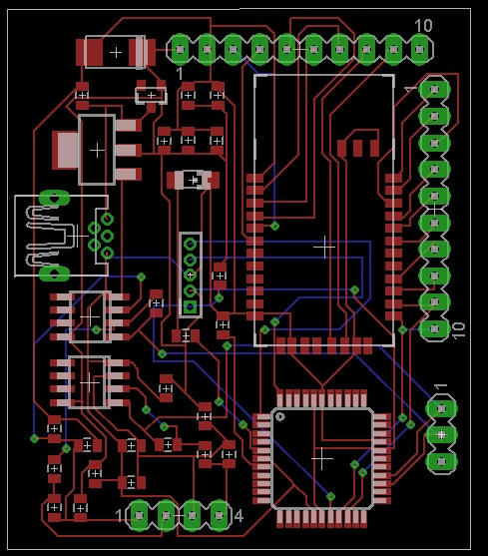
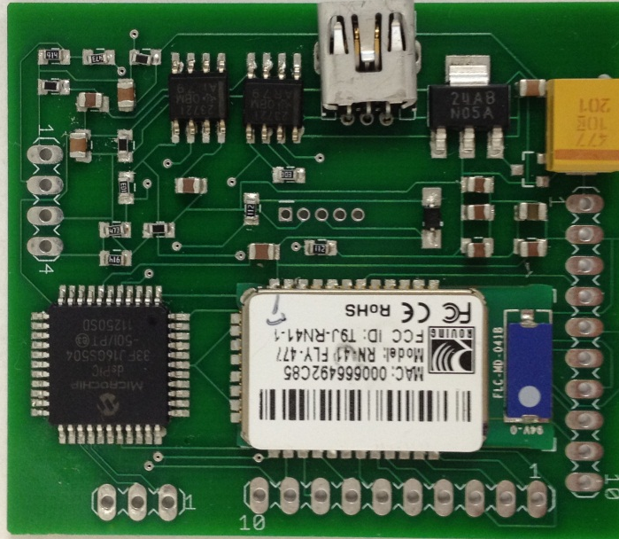
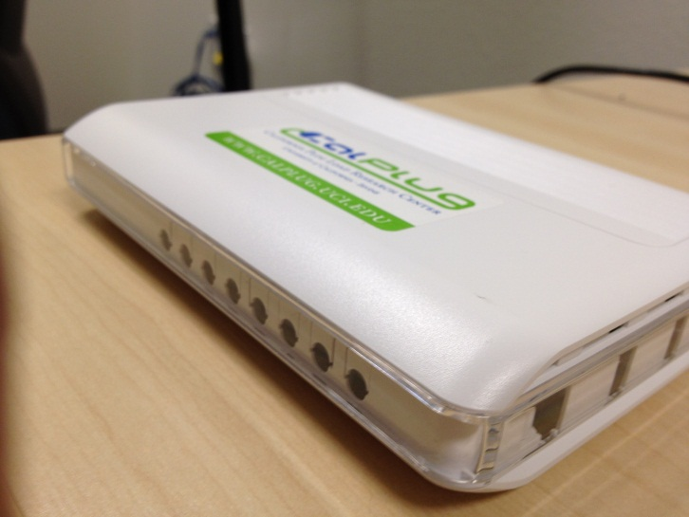
System Integration

Slide 10
